Slide 1
Teauna N. Harper’s Portfolio
“Safeguarding the rights of others is the most noble and beautiful end of a human being.”
-Khalil Gibran

Slide 2
Research Paper Issue
Career Choice: Dentist
Patients’ Rights
  All mentally competent patients should be able to exercise their rights as a patient no matter what the circumstances may be.

Slide 3
The Rights of a Patient
The right to give or not give informed consent
The right to keep medical records private
The right to refuse treatment

Slide 4
The right to give or not give informed consent
One must be informed by a physician of exactly what it is they are consenting to.
After being informed they have the right to say yes or no.

Slide 5
My argument
It’s your body, you should be involved 100% in what happens to it
A physician can not say “Just sign here!”

Slide 6
Counterarguments
In January of 2010, regulators in Hartford, Connecticut began to push for informed consent.
A mandate of this type would ‘single out’ certain professions
  Causing likelihood to suffer

Slide 7
Rebuttal
The livelihood of your job as a physician should be based on the health of the patient and not on the money in your pocket.

Slide 8
The Right to Keep Medical Records Private
My argument
  Making medical records public will allow for biological discrimination.

Slide 9
Counterarguments
Public medical records may help others
  If you know someone’s medical history, you may be able to help them in a medical emergency.

Slide 10
Rebuttal
People can release vital medical information without releasing their entire medical history.

Slide 11
The right to refuse medical treatment
This law also includes the right to receive emergency medical care
  Emergency Medical Treatment and Active Labor Act

Slide 12
Counterargument
Any patient who refuses treatment is not mentally competent and should, therefore, no longer have the right to refuse treatment

Slide 13
Rebuttal
All treatments are not safe and some can do more harm than good
Cancer drug: Avastin
  Side effects include perforations to the intestines, hearts, lungs, and nasal passages

Slide 14
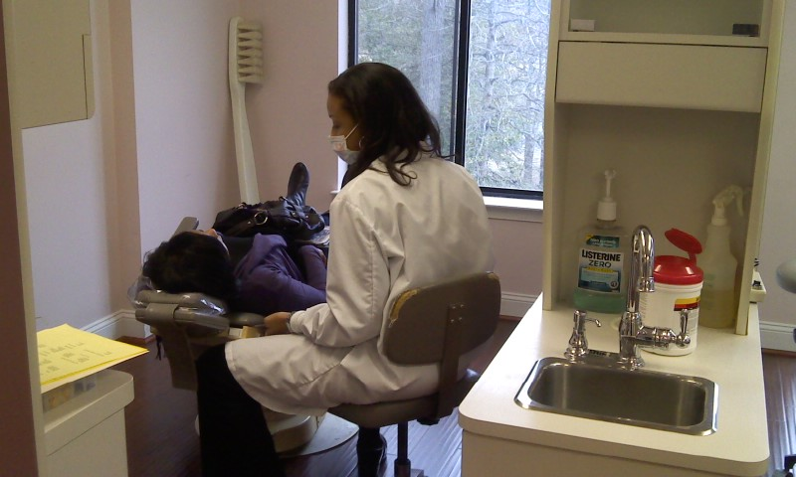
Picture Gallery
Dr. Cathy Wiltshire at Post Office Lake Dental performing her everyday duties as an orthodontist.

Slide 15
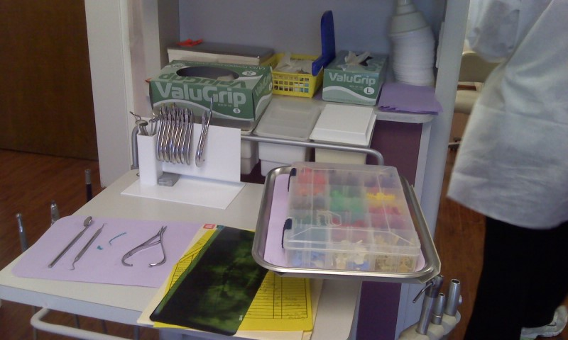
Dental supplies with my x-ray and file .

Slide 16
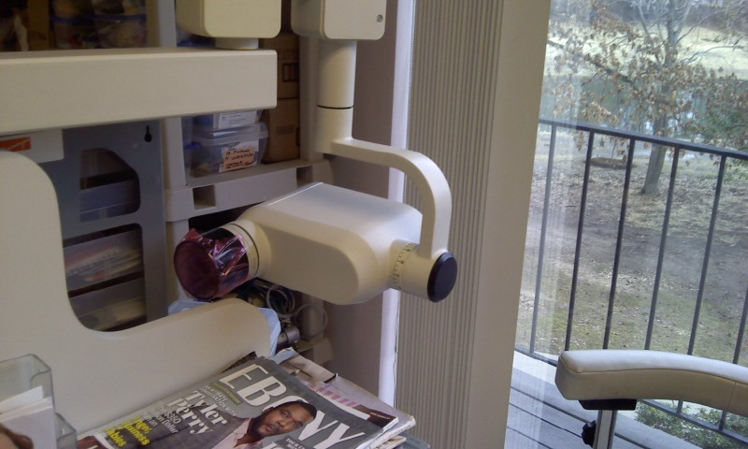
The X-ray machine used to take my x-rays.

Slide 17
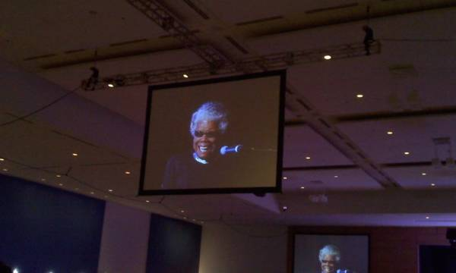
Dr. Maya Angelou (ABRCMS 2010)

Slide 18
Conclusion
If we do not safeguard the rights of others, we are doing a great injustice to ourselves.
First they came… (Martin Niemoller)

Slide 19
Academic Resume
https://docs.google.com/document/d/1de99c5SBwjjEndnn1WoQDoB-WSUX_HDEDbJcvK6__24/edit

Slide 20
Artifacts
National Honor Society Pin
Superior Rating Band Medal
Principal’s Honor Roll Certificate
ABRCMS bag
UMBC Acceptance Letter

Slide 21
Works Cited
Bisceglia, Brandon T. "Dissecting state chiropractic association's arguments against informed consent." Examiner. N.p., 21 Jan. 2010. Web. 8 Oct. 2011.
<http://www.examiner.com/skepticism-in-hartford/dissecting- state-chiropractic-association-s-arguments-against-informed- consent>.
Jain, Manoj. "Intensive care units grow more friendly to patients’ families at some hospitals." The Washington Post [Washington, D.C.] 29 Aug. 2011: Print.
Katie. "The True Stories Behind 8 Famous Courtroom Movies." Blog. Off the Record. Crschools. N.p., n.d. Web. 9 Oct. 2011. <http://www.crschools.net/blog/the-true-stories-behind-8- famous-courtroom-movies>
Makin, Kirk. "Self-Harming Nfld. Teen Loses Right to Refuse Treatment." Globe and Mail (Toronto, Canada). 22 Feb 2010: A.3. SIRS Researcher. Web. 29 Sep 2011.

Slide 22
Paine, Hanne. "Survey Says: Cancer Drug May Do More Harm Than Good." The Statesman [Stony Brook, NY] 26 Apr. 2011: n. pag. Web. 8 Oct. 2011. <http://www.sbstatesman.com/survey- says-cancer-drug-may-do-more-harm-han-good786
"Patient Physician Relationship Topics." American Medical Association. N.p., 2011. Web. 8 Oct. 2011. <http://www.amaassn.org/ama/pub/physicianresources/legal- topics/patient-physician-relationship-topics/informed- consent.page?>.
"Patients' Rights." uslegal. N.p., n.d. Web. 8 Oct. 2011. <http://healthcare.uslegal.com/patient-rights/>.
ProQuest Staff. "At Issue: Patients' Rights." ProQuest LLC. 2011: n.pag. SIRS Researcher. Web. 23 Sep 2011.
"Right to Privacy." UsLegal. N.p., n.d. Web. 9 Oct. 2011. <http://healthcare.uslegal.com/patient-rights/right-to- privacy/>.

Slide 23
"Right to Treatment." UsLegal. N.p., n.d. Web. 22 Oct. 2011. <http://healthcare.uslegal.com/patient-rights/the-right-to- treatment/>
Sack, Kevin. "Patient Data Landed Online After a Series of Missteps." New York Times [New York, NY] 5 Oct. 2011: 1+. Print.
Stein, Rob. "‘Brain stents’ for stroke patients do more harm than good, study shows." The Washington Post [Washington, D.C.] 7 Sept. 2011: Print
Stevens, Justice. "Whalen v. Roe." Cornell University Law School. N.p., n.d. Web. 9 Oct.2011. <http://www.law.cornell.edu/supct/html/historics/USSC_CR _0429_0 589_Z O.html >.
Ward, Victoria. "Judge rejects family's right to die case." The Telegraph 28 Sept. 2011: 1+. Print.

